Slide 1
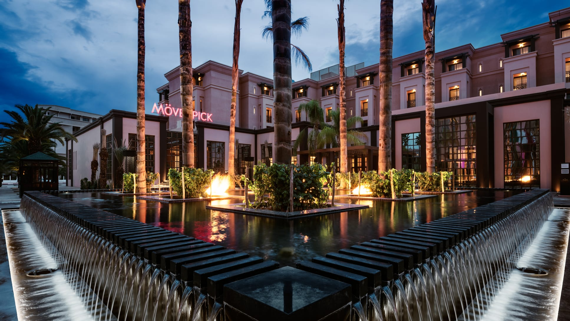

Slide 2
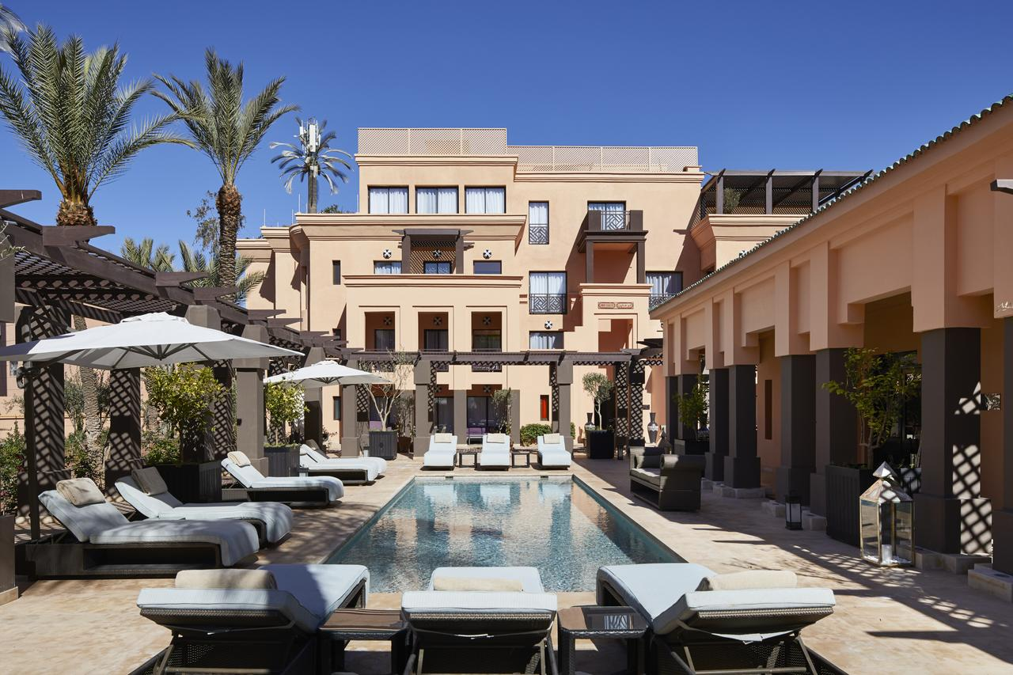
In the heart of Marrakech, in the district of the famous Hivernage, just 4km from the airport and 10 minutes from La Medina, stands this majestic hotel with 503 rooms. This hotel is inspired by Ahmed Al Mansour Eddahbi, sultan of the Saadi dynasty, who propelled Marrakech to new cultural heights.
503 ROOMS

Slide 3
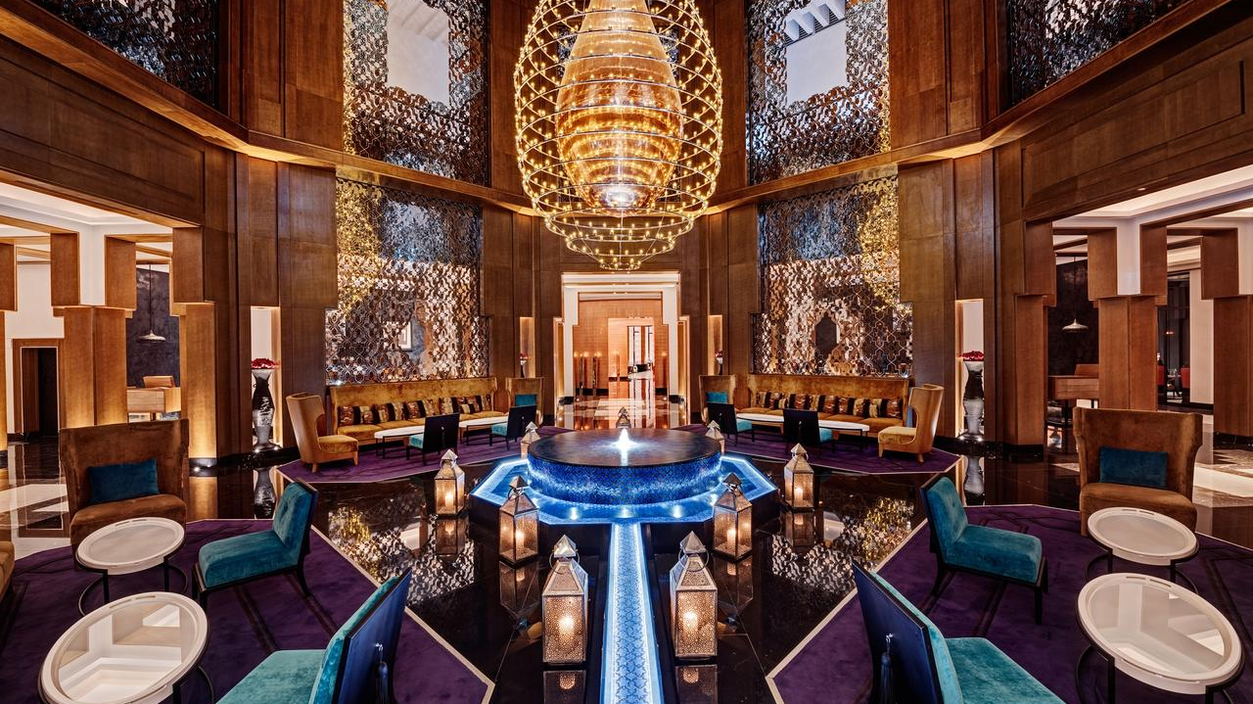

Slide 4
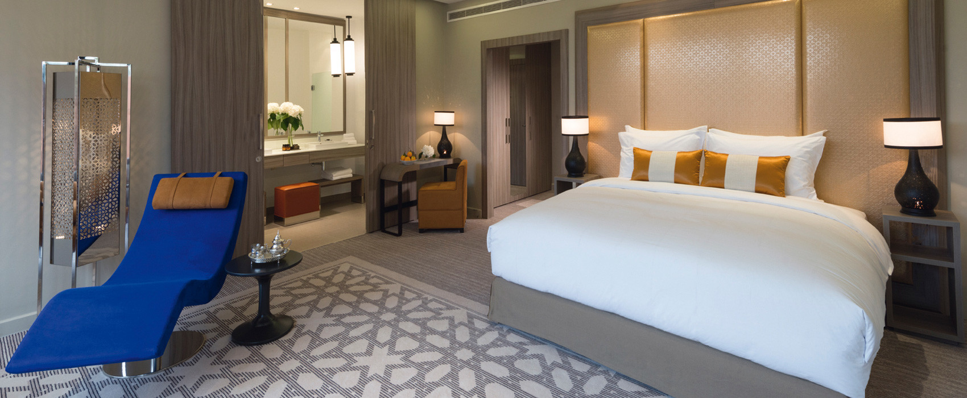
Stay in one of the 503 guestrooms with LCD televisions.
Keep in touch with your loved ones thanks to the free Wi-Fi Internet connection.
Conveniences include phones and safes, and housekeeping is provided daily.
503 ROOMS

Slide 5
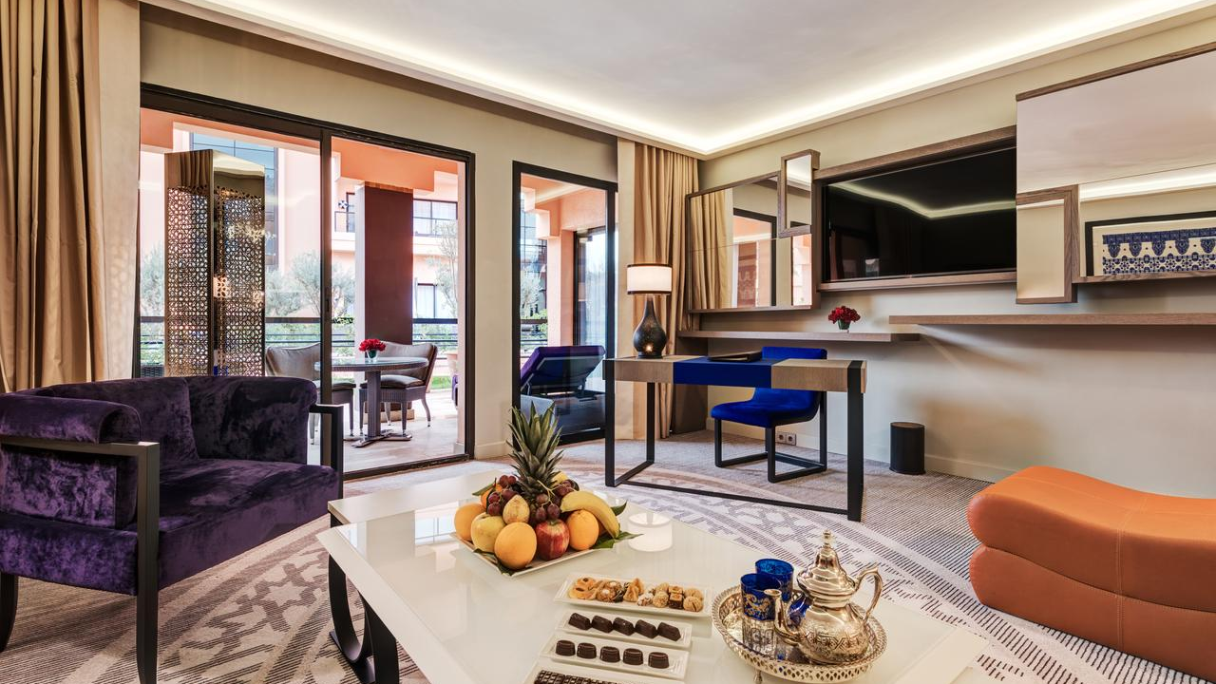

Slide 6
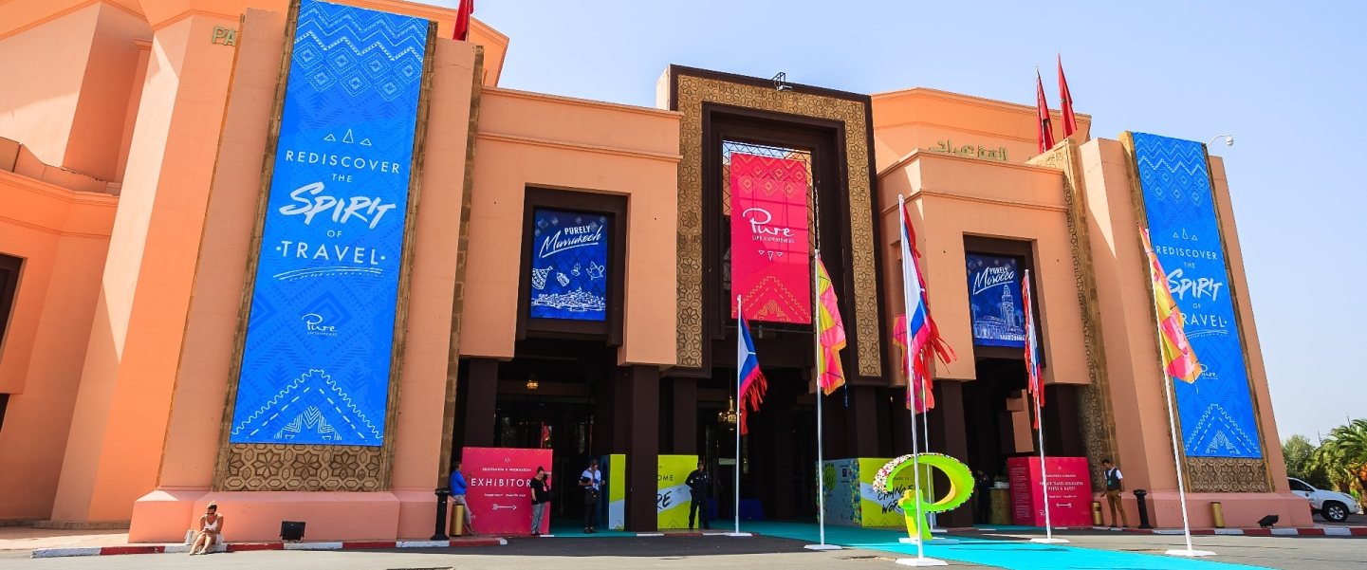

Slide 7
The MOVENPICK houses perfectly equipped spaces ideal for meetings, events and conferences. In addition, offering an exclusive ticket for groups, the congress palace houses more than 5600m2 dedicated to making your meeting unique.
2 Auditoriums
1 Great Royal Hall
2 Sub-plenary chambers
16 Rest romos
A registration room
More than 3 000 m2 for exhibition in doors.

Slide 8
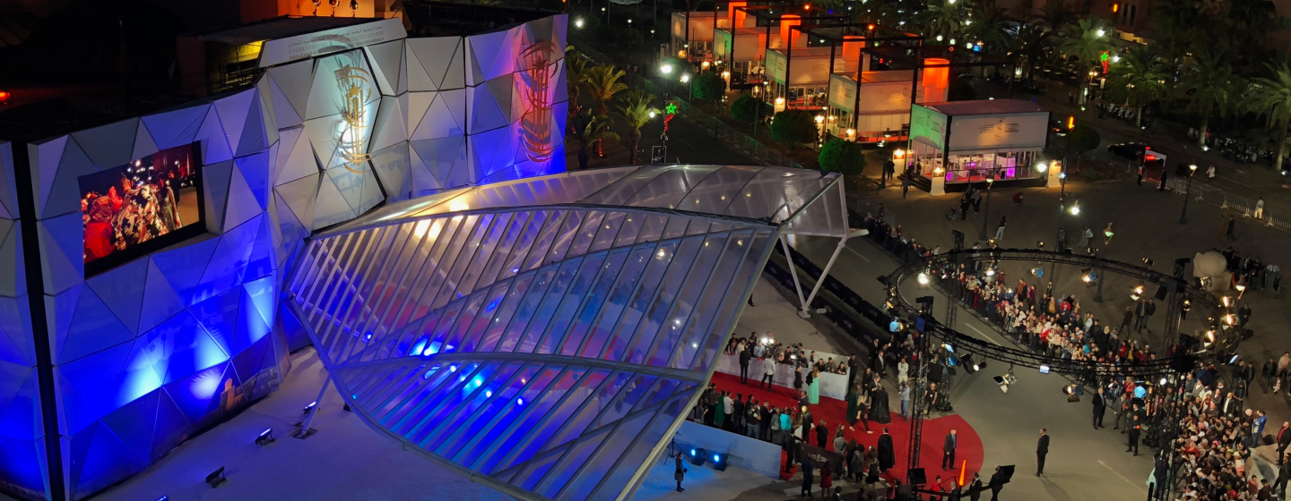
MANSOUR EDDAHBI

Slide 9
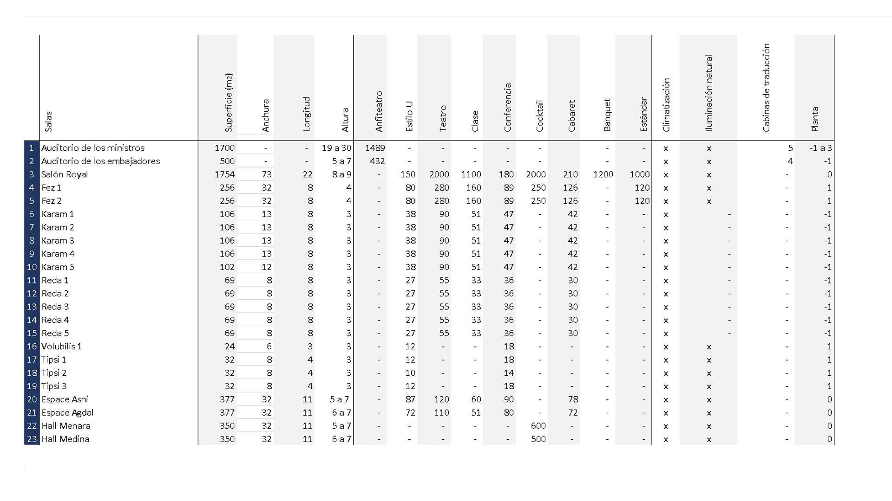
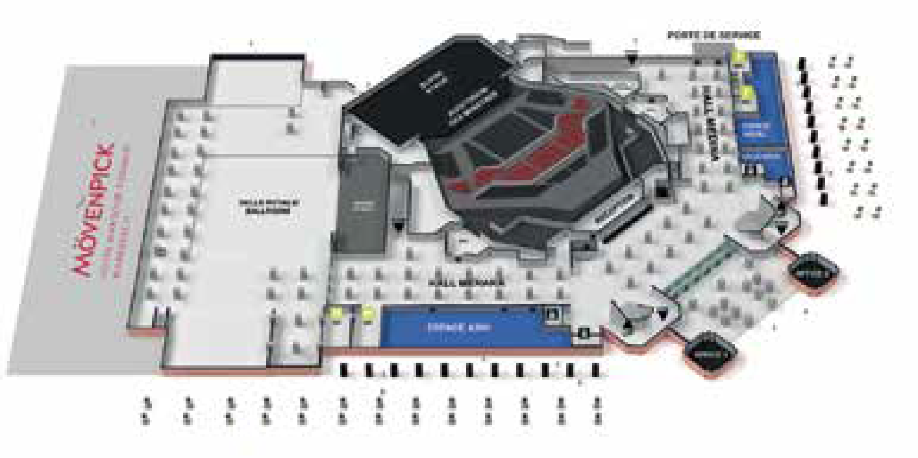
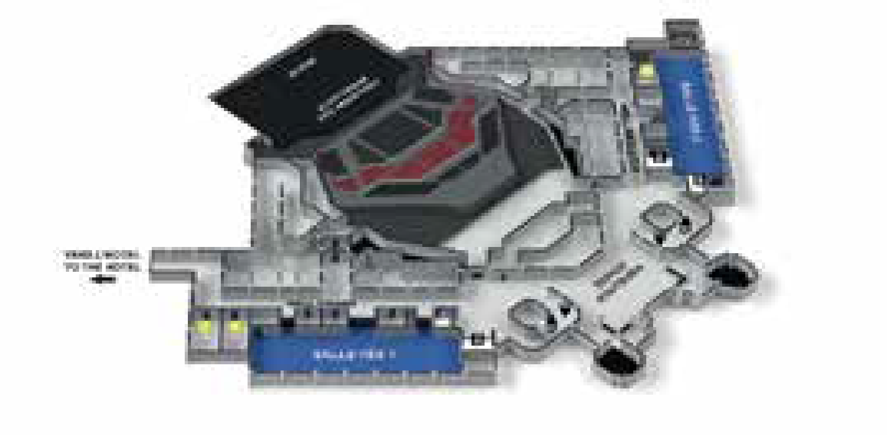
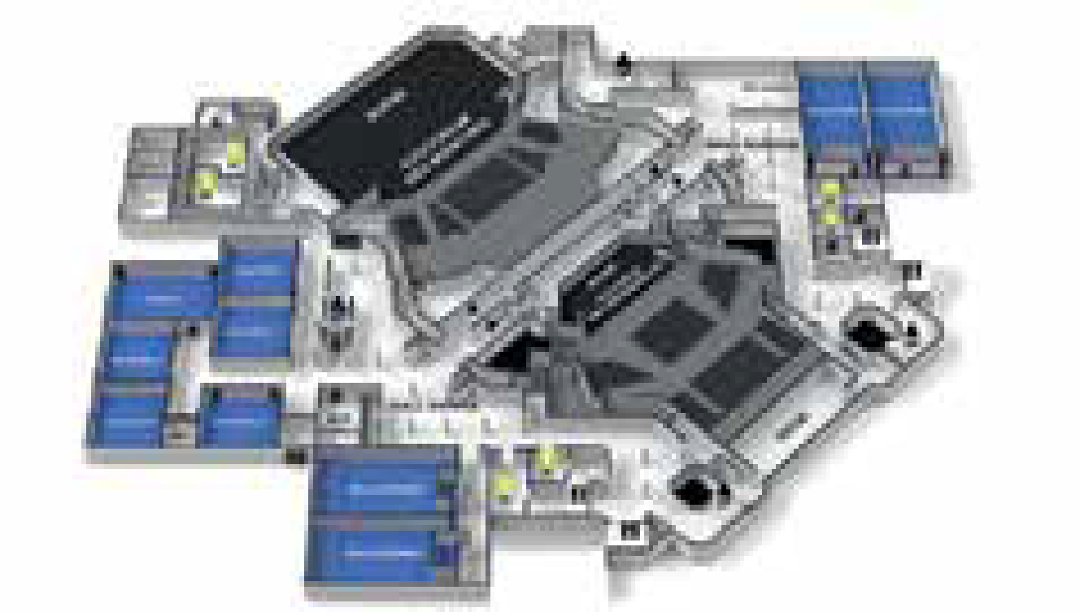

Slide 10
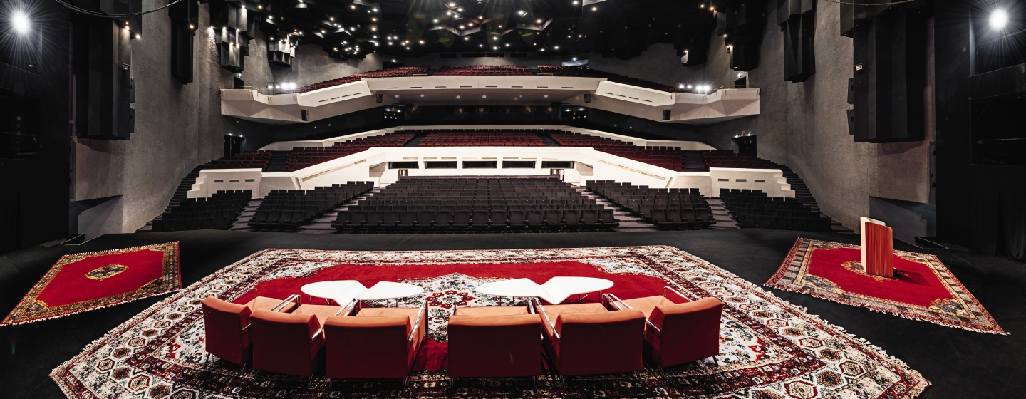
DIMENSIONS AND ACCESS
Stage area: 650 square meters
Afforestation area: 200 square meters.
The length varies between 25 and 30 m.
Stage depth: 27 m.
Stage opening: 20m x 10m high.
This space houses the largest auditorium in the congress hall with a capacity of 1469 seats. This room is divided into 4 different levels:
Orchestra level: 338 seats
Mezzanine 1: 416 seats.
Mezzanine 2: 285 seats.
Balcony: 450 seats.

Slide 11
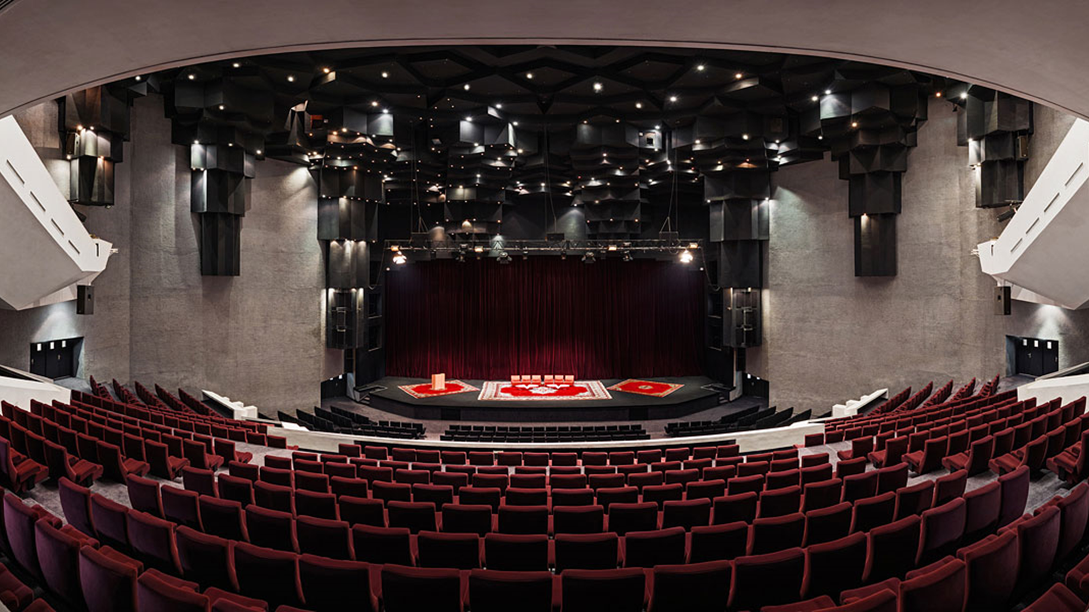

Slide 12
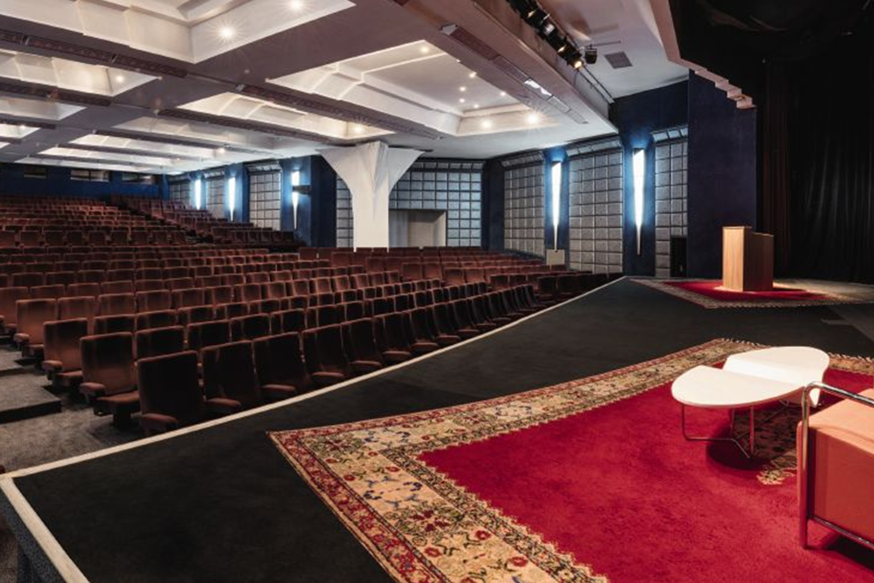
This space has 432 seats arranged in 2 levels.
Orchestra: 220 seats Mezzanine: 212 seats.
DIMENSIONS AND ACCESS
• Stage area: 80 square meters
• Length: 11m to 13m.
• Stage depth: 6 m.
• Stage opening 11 m wide
• Stage height: 6 m.

Slide 13
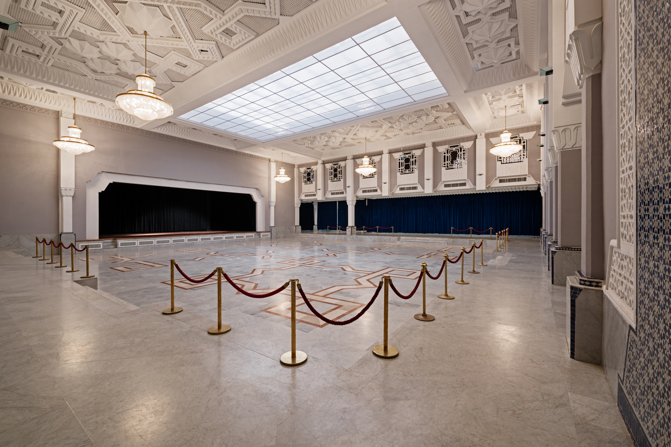
ROYAL’S ROOM
This impressive lounge with Mozarabic décor is a perfect place for your private exhibition, dinner and/or show. It is one of the largest spaces in the Marrakech Congress Centre with multiple options and configurations.

Slide 14
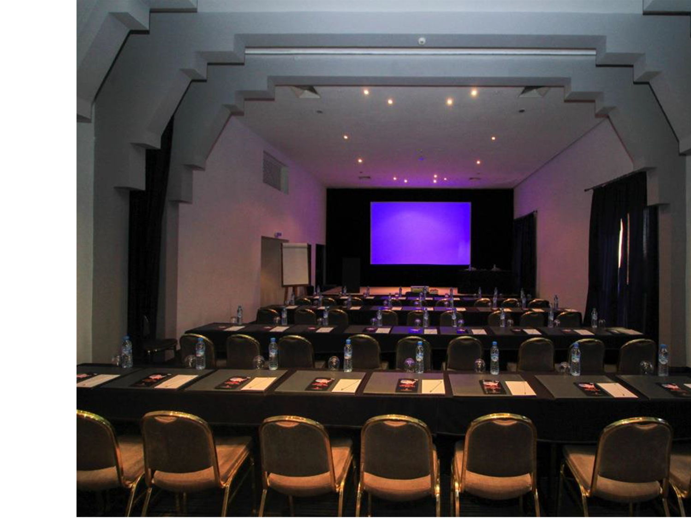
FEZ 1 and FEZ 2 ‘S ROOMS
The two meeting rooms Fes 1 and Fes 2 are on the top floor of the congress centre. Both rooms have sunlight and can be divided into 3 at a time. The measures are:
Area: 256 square meters
Length: 32m - Width: 8m
Height 4.40m
Possible configurations :
280 pax in theatre style 160 pax in school style 80 pax in "u"

Slide 15
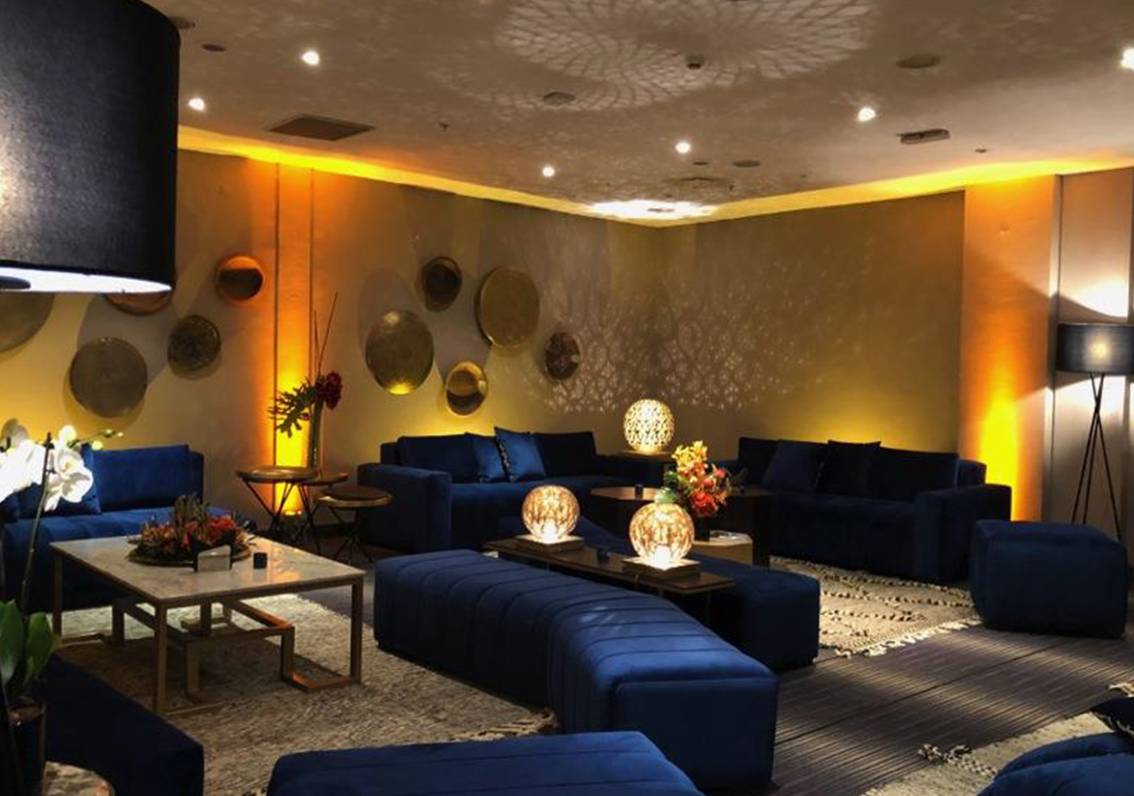
REDA and KARAM’S ROOMS
The MOVENPICK MANSOUR EDDAHBI Congress Centre has perfectly equipped meeting rooms:
REDA
Five conference rooms measuring 69m2 each, located next to each other. They can accommodate up to 55 people each in theatre style and 30 in school style, allowing a great optimization of space.
KARAM
They can accommodate up to 100 people each in theater style and 55 people in school. They have integrated stage.

Slide 16
